Slide 1


Real-Time Face Recognition
Presented by
Rashed Syed

Slide 2
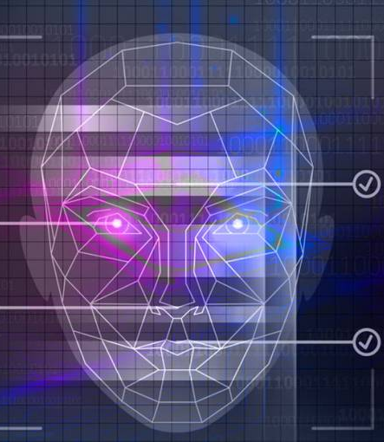
Introduction:
Facial recognition technology has rapidly evolved, leveraging advanced algorithms to analyze and identify unique facial features for various applications.
Among the array of algorithms used in facial recognition, the k-nearest Neighbors (k-NN) algorithm has gained traction for its simplicity and efficiency in classifying data points based on their similarity to neighboring instances.
By examining the intricacies of facial recognition through the lens of k-NN, we aim to provide a comprehensive understanding of the principles, methodologies, and practical considerations involved in this technology.
Key areas of exploration include data collection, preprocessing techniques, feature extraction methods, classifier training, and the execution of real-time recognition tasks
Notes:
Facial recognition is an advanced technology that involves the automated identification or verification of individuals based on their unique facial features. It utilizes algorithms to analyze and compare patterns, shapes, and proportions of facial characteristics captured from images or video frames. By mapping specific facial landmarks such as the distance between eyes, nose shape, and mouth structure, facial recognition systems can accurately match faces against stored databases or identify individuals in real-time. This technology has found widespread applications in security, access control, personal devices, and marketing, fundamentally changing how we interact with digital systems and environments
Facial recognition using the K-Nearest Neighbors (KNN) algorithm is a technique that involves identifying or verifying individuals based on their facial features by comparing them to a database of known faces.

Slide 3
Utilization of deep learning across various industries
Healthcare:
Deep learning improves medical image analysis and disease diagnosis.
Applications include MRI and X-ray interpretation and genomics research.
Transportation:
Deep learning advances autonomous vehicles and intelligent transportation systems.
Used for object detection, lane detection, and predictive maintenance.
Security:
Deep learning enhances security through facial recognition and video surveillance.
Applications include threat detection, anomaly detection, and cybersecurity.

Slide 4
Facial recognition with K-NN
Data Collection and Preprocessing
Collection of facial images and preprocessing steps to enhance quality and consistency.
Feature Extraction
Extraction of facial features such as eyes, nose, and mouth from images.
Conversion of features into numerical vectors for processing.
Training the k-NN Classifier
The process of training the k-NN algorithm using a labeled dataset of facial feature vectors.
Learning to classify new facial images by comparing them to nearest neighbors in the feature space.
KNN Algorithm
Overview of the k-nearest Neighbors (k-NN) algorithm and its role in facial recognition.
Explanation of how the algorithm identifies the k nearest neighbors based on feature similarity.

Slide 5
Distance Calculation
1. Calculation of distances between feature vectors to measure similarity.
2. Common distance metrics such as Euclidean distance or cosine similarity.
Nearest Neighbors Selection
Selection of the k nearest neighbors based on calculated distances.
Determining the most similar facial feature vectors to the input image.
Classification
Assigning a class label to the input image based on the majority class among the nearest neighbors.
Determining the recognized individual or classifying the input image as unknown.
Recognition
Application of the trained k-NN classifier for real-time facial recognition tasks.
Identifying individuals based on their facial features using the trained model.

Slide 6
The Future Landscape of Facial Recognition:
3D Facial Recognition Advancements:
Transition from 2D to 3D facial recognition technology.
Depth information enhances accuracy and reliability.
Improved performance in challenging conditions like lighting variations and facial expressions.
Emotion Recognition Integration:
Integration of emotion recognition in facial recognition systems.
Applications in marketing, healthcare, and human-computer interaction.
Enables more personalized and empathetic interactions.
Age Progression and Regression Capabilities:
Advancements enabling age progression and regression predictions.
Potential applications in forensic science and missing persons cases.
Personalized healthcare opportunities for understanding aging patterns.

Slide 7
Enhancing Performance in Challenging Environments:
Focus on improving facial recognition in challenging conditions.
Techniques like robust feature extraction and domain adaptation.
Aimed at boosting system robustness in low-light, crowded, and noisy environments.
Privacy-Preserving Techniques Implementation:
Integration of privacy-preserving techniques in facial recognition.
Methods include federated learning, differential privacy, and secure computation.
Balancing facial recognition model training and deployment with individual privacy protection.
Ethical and Regulatory Considerations:
Establishment of ethical guidelines and regulatory frameworks.
Collaboration among policymakers, industry, and civil society.
Addressing concerns related to bias, discrimination, privacy, and human rights in facial recognition technology deployment.

Slide 8
Leading innovators in Facial Recognition Technology:
Microsoft
Amazon
Face++(Megvii)
Google
IBM
Facebook

Slide 9
Limitations of Facial Recognition
Potential for Misuse and Abuse: Authoritarian governments or individuals may abuse facial recognition technology for population surveillance and control. Inadequate protections run the risk of violating people's right to privacy and civil liberties. For example, the technology might make it possible to track people's movements in great detail, which could result in discrimination and exclusion from public life.
Ethical Dilemmas: Although facial recognition can unlock smartphones and provide personalized experiences, its widespread use without oversight creates ethical questions. Individual rights and societal values must be carefully considered to weigh the advantages of technology against any potential risks.
Bias and Inaccuracy: Facial recognition systems may exhibit bias and inaccuracies, particularly concerning different demographic groups. Imbalanced datasets and variations in false positive or false negative rates across racial minorities can result in disproportionate impacts on marginalized communities. This perpetuates existing disparities and undermines fairness and equity.

Slide 10
Conclusion
Facial recognition technology has evolved significantly, driven by advancements in deep learning models and algorithms.
Its applications span across various industries, including security, retail, healthcare, and entertainment.
The technology enables tasks such as face detection, verification, identification, and emotion analysis with remarkable precision.
While its widespread adoption brings benefits like improved security and personalized experiences, it also raises concerns regarding privacy, ethics, bias, and civil liberties.
Addressing these concerns requires careful regulation and responsible deployment to ensure the technology's ethical and fair use while maximizing its potential benefits.

Slide 11
Thank you for your attention!

